Slide 1
On the use of test smells for prediction of flaky tests
By Bruno Henrique Pachulski Camara, Marco Aurélio Graciotto Silva, Andre T. Endo, Silvia Regina Vergilio
Presented by: Pranay Reddy Juturu , Ashay Pable and Diya Sanghvi

Slide 2
Outline
Context
Problem
Solution
Limitations
Approach Overview
Validation

Slide 3
Context
Regression testing is a key milestone in delivering high-quality software.
Flaky testing make it difficult to evaluate test results and can raise expenditures.
Vocabulary-based approach may be context-sensitive and prone to overfitting, resulting in poor performance when used across projects.
By examining test smells in the test code, a unique method for predicting flaky tests is provided.

Slide 4
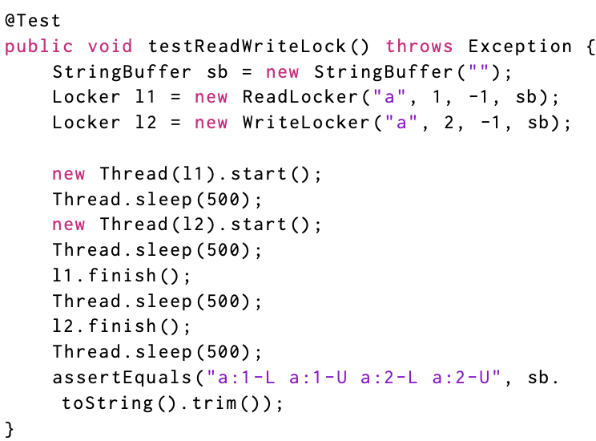
Problem
Regression testing is a crucial step in producing high-quality software.
Flaky tests, make it difficult to evaluate test results and can raise expenditures.
Tests that pass or fail nondeterministically are referred to as flaky tests, and it might be challenging to tell whether they are genuinely passing or failing.
This might result in false positives and false negatives, making it challenging to find flaws and guarantee the quality of software.
Notes:
SleepyTest and Sensitive Equality

Slide 5
Solution
The solution proposed is to use “test smells” as features to predicting flaky tests.
Test smells are similar to code smells in that they are signs of poor code design or implementation, but they are particular to faults in test code that can cause the tests to be unreliable or fail.
The proposed technique begins by identifying a set of test smells typically linked with flaky tests, such as employing thread.sleep() or non-deterministic assertions.
Evaluation Metrics: Precision, Recall, F1- Score, MCC (Matthews correlation coefficient) and AUC(area under the ROC curve).
Notes:
Precision: The number of correctly classified flaky / total number of tests classified as flaky. Recall: The number of correctly classified flaky / total actual number of flaky tests F1-score: Harmonic mean of precision and recall. MCC: correlation between predicted classed and ground truth.[-1,1] AUC: Curve which visualizes the trade-off between true-positive and false-positive rates.

Slide 6
Limitations
The approach is dependent on the availability of labeled data for training the classifiers, which can be costly and time-consuming to collect.
The performance of the classifiers is determined by the quality of the training features. When crucial features are overlooked or irrelevant features are included, classification performance suffers.
The solution does not address the underlying reasons for flaky tests; rather, it merely provides a means for recognizing them. To lessen the recurrence of flaky tests, it may be required to address the underlying flaws in the code.
The solution does not explain how to resolve flaky tests after they are discovered. Developers may still need to analyze and resolve flakiness issues manually.

Slide 7
Approach Overview
Eight classifiers are used , Random Forest, DT, Naive Bayes, SVM , LR, LDA. KNN and Perceptron.
In Cross-project perspective, “idFlakies” dataset is used. Recall is the only metric used as the dataset does not contain examples of non-flaky tests.
First, test smells are identified and extracted. A machine learning approach that uses test smells to train a classifier to predict whether a test was flaky is used.
19 Test Smells are selected as features for the model.

Slide 8
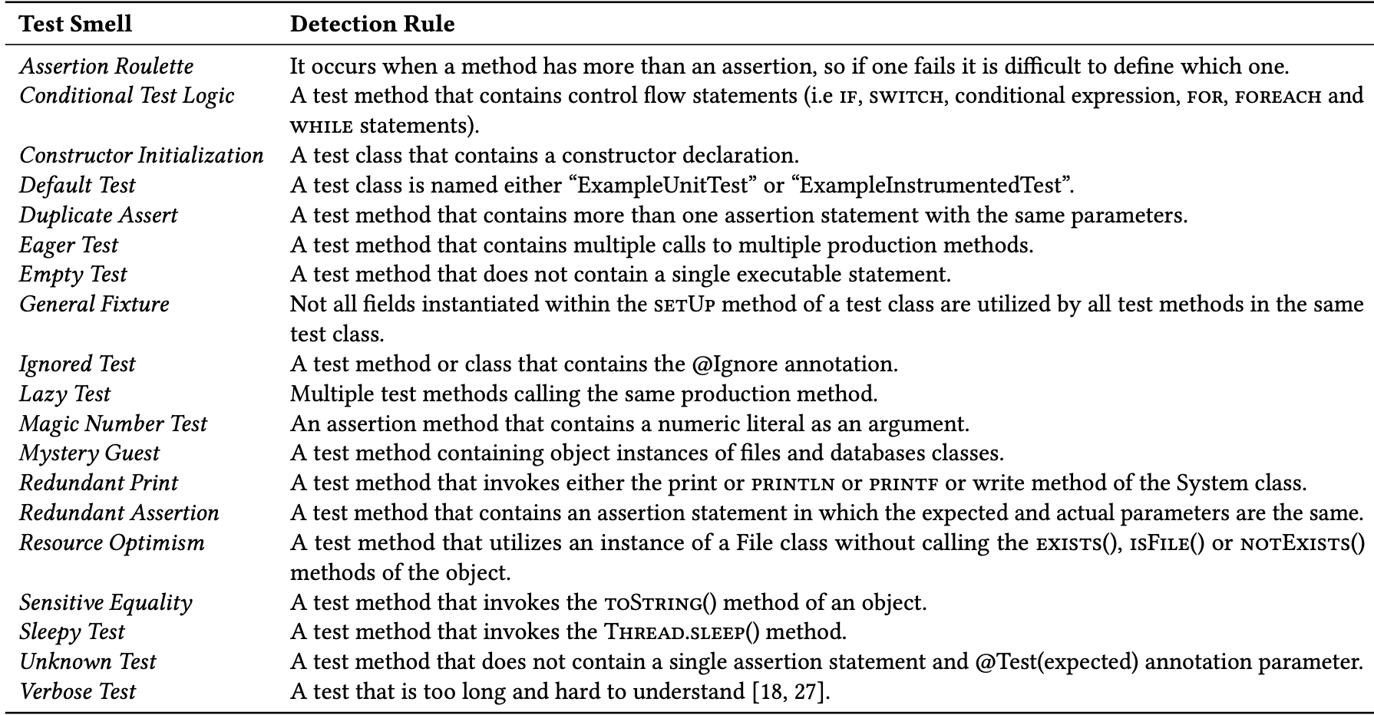

Slide 9
Validation
RQ1: How accurately can we predict test flakiness based on test smells in the test cases?
RQ2: Which test smells are most strongly associated with test flakiness prediction?
RQ3: How does test smell-based approach compare with the existing vocabulary-based approach?

Slide 10
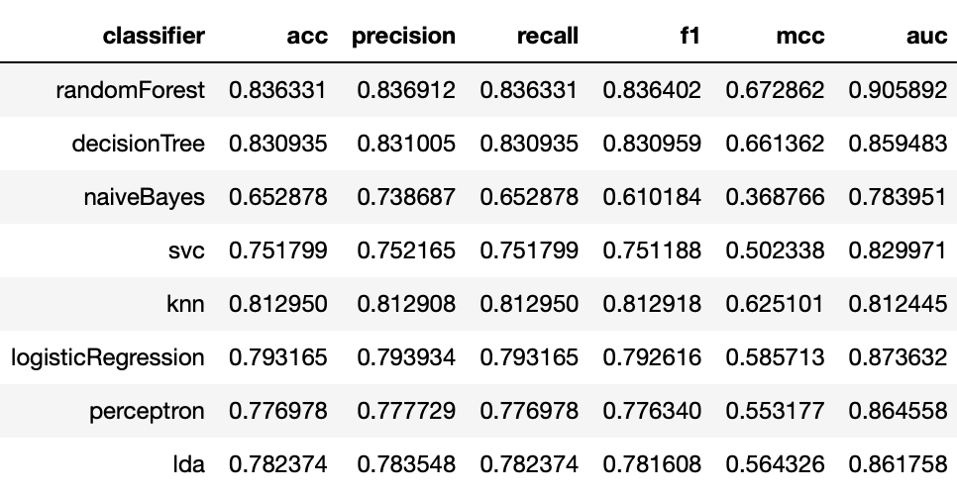
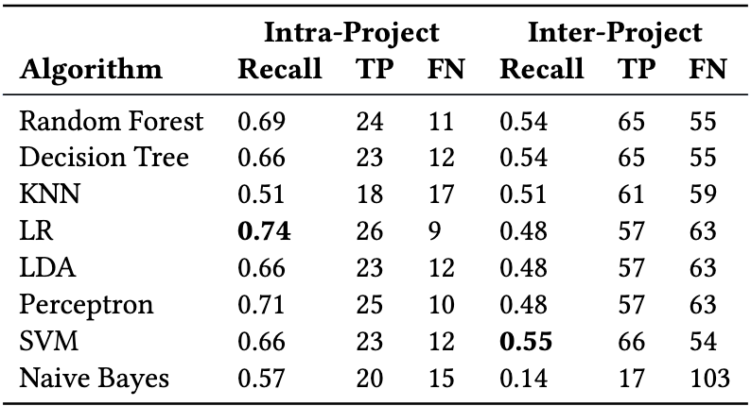
RQ1: How accurately can we predict test flakiness based on test smells in the test cases?
The precision, recall, F1-score, AUC values of all the classifiers are greater than 70% except Naive Bayes. The MCC of all the classifiers is >0.5 which is close to 1 except Naive Bayes.
Test-smell based models have good performance to predict test flakiness. Random forest and decision tree are the best performing classifiers while Naive Bayes performers poorly.
Considering the intra-project context, the performance of all classifiers declined to recall values ranging from 51% to 74%, with LR achieving the greatest result by accurately classifying 26 of 9 flaky tests.
The classifiers' performance declined dramatically in the inter-project context. However, with the exception of Naive-Bayes, which achieved a value of 14%, there is little variation amongst the classifiers, with recall values ranging from 48% to 55%. SVM achieved the best results.

Slide 11
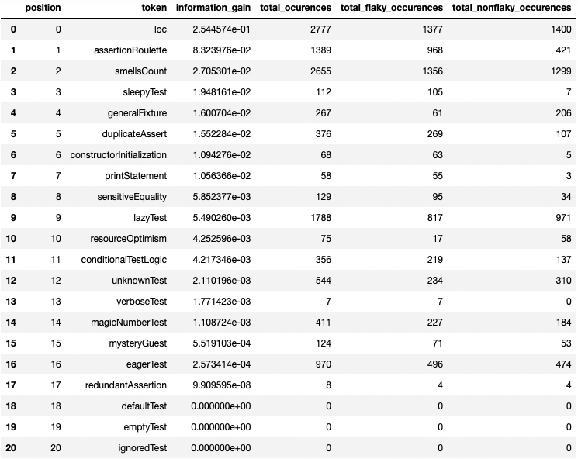
RQ2: Which test smells are most strongly associated with test flakiness prediction?
Information gain of each feature is calculated to determine the most relevant features associated with test flakiness.
The information gain is a metric that measures how much information a characteristic gives for predicting the target variable, in this example, test flakiness. The higher a feature information gain, the more useful it is for predicting the target variable.
Four test smells with at least 90% of affected tests being flaky when we consider the contribution of the test smells to the model. They are: Verbose Test (100%), Redundant Print (94.83%), Sleepy Test (93.75%), and Constructor Initialization (92.65%). Sleepy Test and Constructor Initialization are two examples. These smells are often connected with flaky tests.

Slide 12
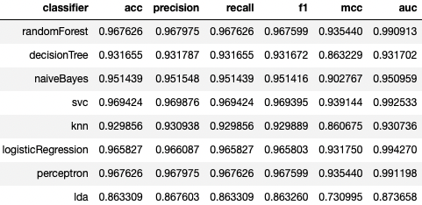
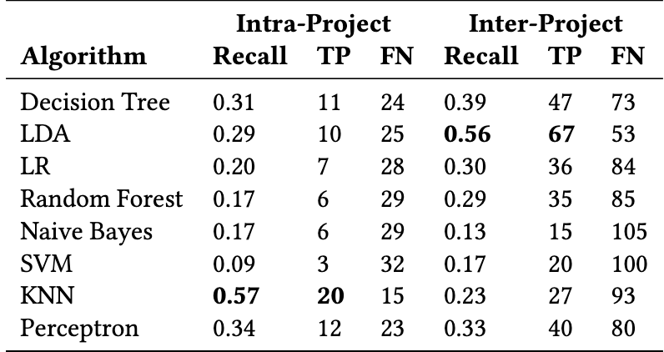
RQ3: How does test smell-based approach compare with the existing vocabulary-based approach?
The acquired performance of intra-project classifications, KNN is the top classifier in this case, with 57% recall. Inter-project, LDA has a recall of 56%.
Compared to test-smell based approach, vocabulary based approach yields better results. Random forest classifier in test-smell based approach had a F1-score of 83% whereas in vocabulary approach it is 96.7%.
The disparity is greater when MCC is analyzed. The best result produced by the smell-based technique is 0.66, whereas the best result obtained by the vocabulary-based approach is 0.94.

Slide 13
The cross-project validation results demonstrate that the test smell-based approach achieves better results.
In the intra-project context, the test smell-based technique achieved 74% recall (LR), while the vocabulary-based approach only achieved 57% (KNN).
When the best classifiers in the inter-project context are considered, the smell-based technique obtained a recall of at most 55% (SVM), compared to 56% for the vocabulary-based (LDA).
However, when all classifiers are considered, we see that the smell-based strategy outperforms the vocabulary-based approach in cross-project validation.

